Slide 1
IEEE Project Competition
Week 8: Intro to Sensors Workshop

Slide 2
Updates
BOM’s due Nov 30th!!! Get to it!
Intro to sensors workshop. What is tinkercad -> Downloading -> I2C -> LED Button -> Servo Potentiometer -> MISC Items.
Final time for assistance, may host virtual office hours next Monday 7-8.

Slide 3
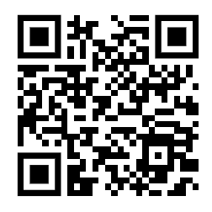
Attendance

Slide 4
How it Works
Use the Arduino IDE or Tinkercad to write code (called a “sketch”) in C++.
Example: A sketch might turn an LED on for 1 second, then off for 1 second (Blink code).
Connect Arduino to your computer via USB, or in Tinkercad, upload virtually.
The code is uploaded to the Arduino’s microcontroller
The Arduino microcontroller continuously runs the uploaded code in a loop.
Inputs are read and processed; outputs are controlled accordingly.
Key Components
Digital Pins: Send HIGH (on) or LOW (off) signals to control LEDs, motors, etc.
Analog Pins: Read variable inputs, like sensor data (e.g., light intensity).
Power Supply: Arduino can be powered by USB or external sources.

Slide 5
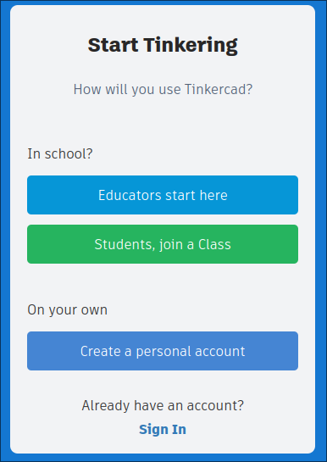
TinkerCad
Tinkercad is a free, web-based platform for designing 3D objects and simulating electronics, including Arduino circuits.
Code and run Arduino projects virtually without needing physical hardware.
Create a free TinkerCad account: https://www.tinkercad.com/join

Slide 6




https://www.autodesk.com/education/edu-software/overview?sorting=featured&filters=individual#
Or you can create an autodesk education account using this link to get access to other autodesk products!

Slide 7
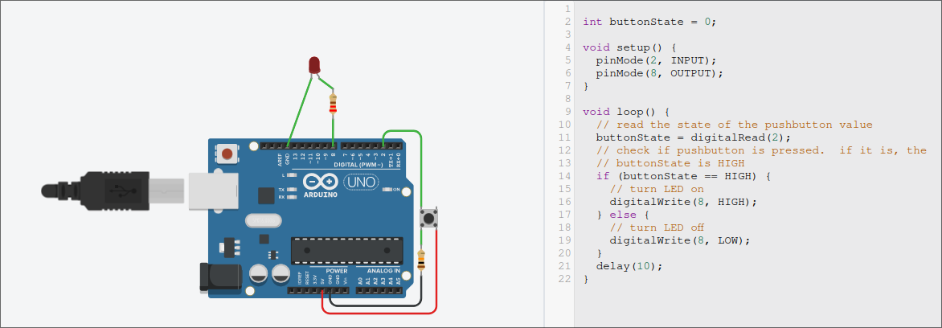
LED/Button
More Parts:
220 Ω resistor for LED
10k Ω resistor for button
Button
Function:
Turns on an LED whenever a button is pressed

Slide 8
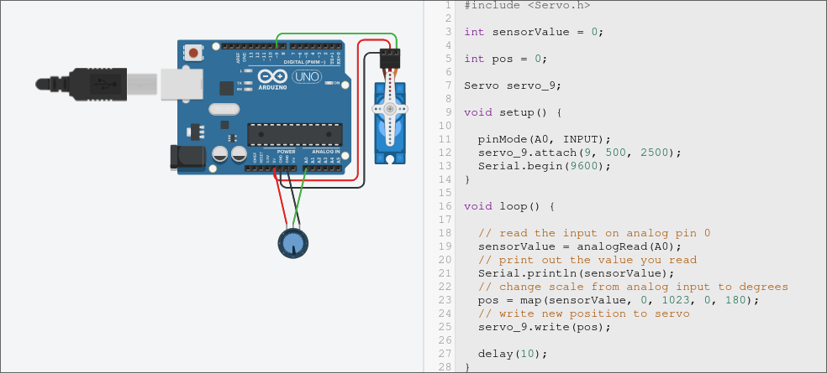
Servo w/ Potentiometer
Parts:
Arduino Uno R3
Servo
Potentiometer
Function:
Control a servo’s position by using a potentiometer

Slide 9
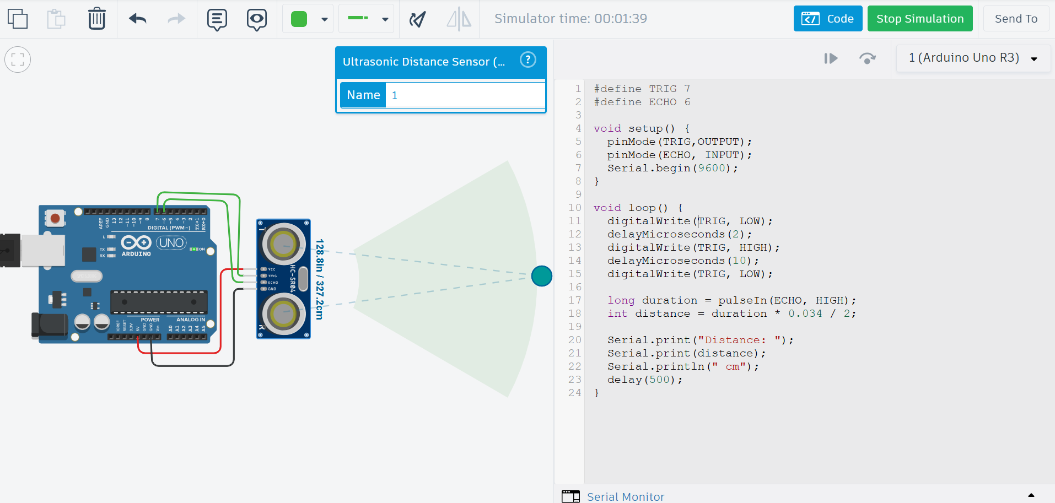
Measuring Distance with an Ultrasonic Sensor
Parts:
Arduino Uno R3
Ultrasonic Sensor
Function:
Measure the distance of an object.

Slide 10
I2C
I2C (Inter-Integrated Circuit) is like a simple communication system for electronics. It uses only two wires:
1. SDA (Data Line): Carries the actual data between devices.
2. SCL (Clock Line): Keeps everything synchronized.
There’s always one "master" device that controls the communication and one or more "slave" devices that respond. Each device has a unique address, so the master knows who it’s talking to. It’s efficient because multiple devices can share the same two wires, making it great for connecting sensors, displays, and other components.

Slide 11
Timeline and Important Dates
Weekly Meetings - Estimated Timeline
Week 1 | Week 2 | Week 3 | Week 4 | Week 5 | Week 6 | Week 7 | Week 8 | Week 9 | Week 10
Introduction | Microcontrollers - Erik | Fusion 360/Solidworks - Matias | KiCAD -Tino | General Project Management Skills/ Github/ BOM’s | Technical Assistance Focused | Git and GitHub Workshop | Technical Assistance Focused (Veterans Day) | Intro to Sensors | Winter Break (BOMs due 30th Nov)

Slide 12
Questions?

Slide 13
Updates
NOV 30th!
Virtual assistance 7-8PM Monday discord!

